Slide 1

Jamie Clark CIS 700 – Machine Learning and Cybersecurity
Notes:
Recommending picking out he most interesting and important parts from your documentation.

Slide 2
Agenda
Summary
Previous/Other Contributions
Training methods
Important findings

Slide 3
Summary
Find out if combining the text and non-text data will produce better results in determining if a job post is legitimate or fraudulent.
Text data broken into three groups of 200, 1,000 and 2,000 vectorized words.
Final combination efforts took place with the 1,000 vectorized words since it produced the best results.
Notes:
Example dot points
Most important classifier was XGBoost
The three most important features were car color, make of the car, number of miles
One of my biggest insights was that building a separate classifier for each brand of car gave me a big performance improvement
Used Python (Pandas and XGBoost)

Slide 4
Previous/Other contributions
All previous work comes from https://www.kaggle.com/shivamb/real-or-fake-fake-jobposting-prediction

Slide 5
Training Methods
Training methods selected to show improvement rather than the best algorithm.
K Means
Decision Tree Classifer
Nearest Neighbor Classifier
Naïve Bayes
Random Forest Classifier
Gradient Boosting Classifer
Ada Boost Classifier

Slide 6
Important Findings
Improvements of combined data, on average
ROC increased 5.75%
Accuracy increased 2.66%
Time 35.68%
4.3 seconds to 5.9 seconds

Slide 7
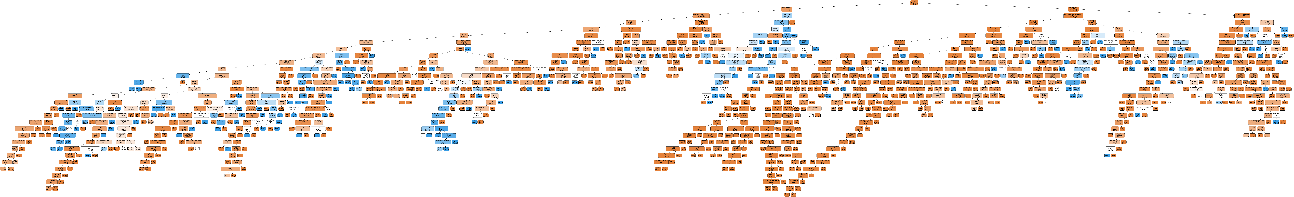
Interesting visualization found when exploring the data
Important and Interesting Findings

Slide 8
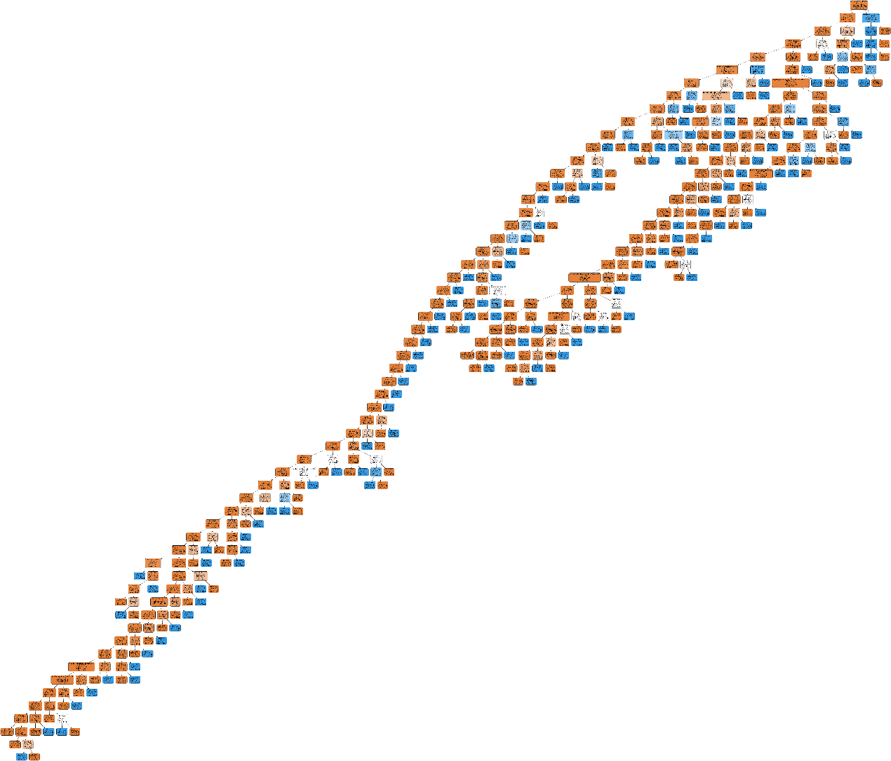
Interesting visualization found when exploring the data
Important and Interesting Findings

Slide 9


